Slide 1

E-Library UML

Slide 2

Content
Introduction
ER diagram
System screens

Slide 3

Introduction
This is a e-library which support member book borrow and return
There is two type of users who are administrator and member or user
Administrator can maintain the book list and user/member
Users can use the e-library to register their accounts, book borrow and return

Slide 4
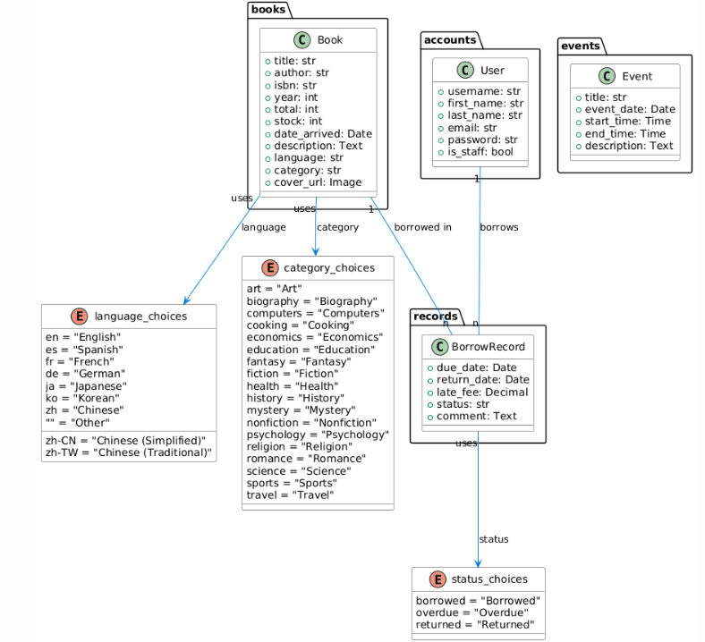
ER Diagram

Slide 5
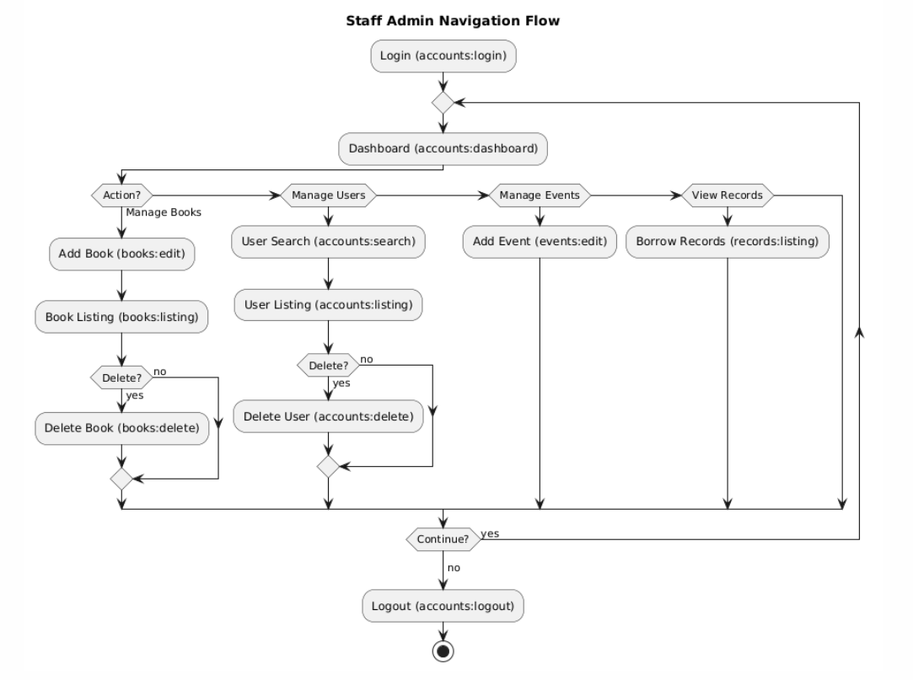

Slide 6
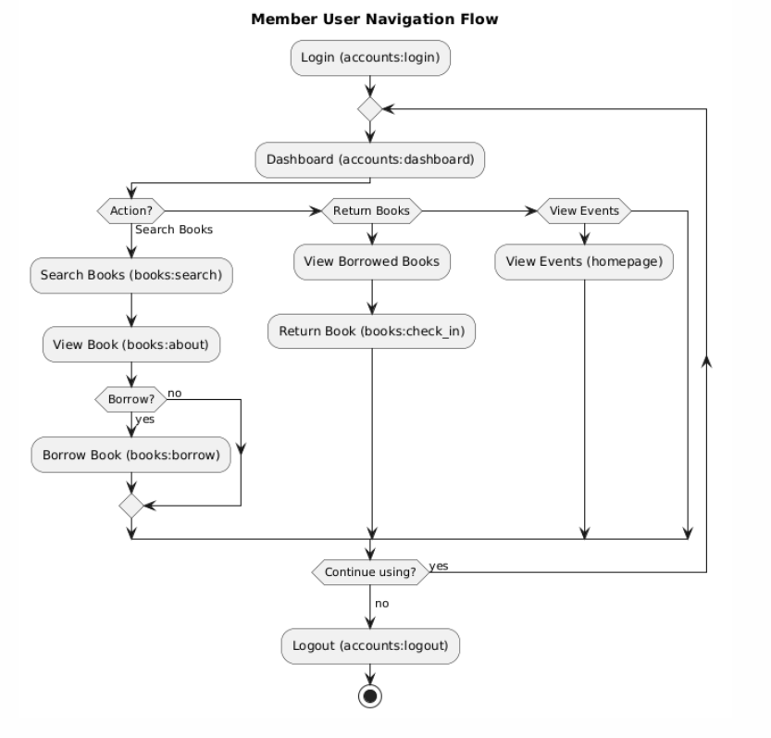

Slide 7
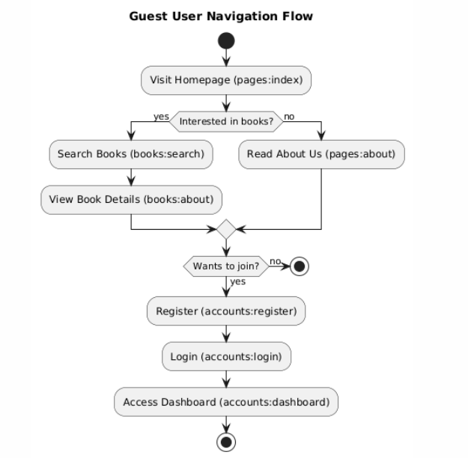

Slide 8
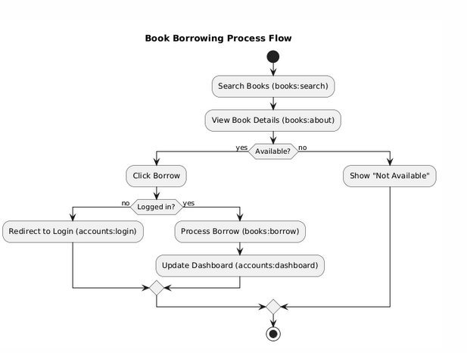

Slide 9
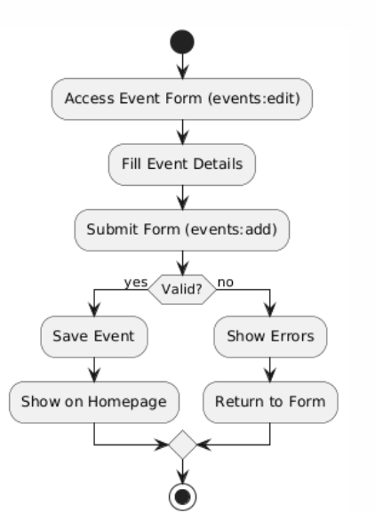

Slide 10
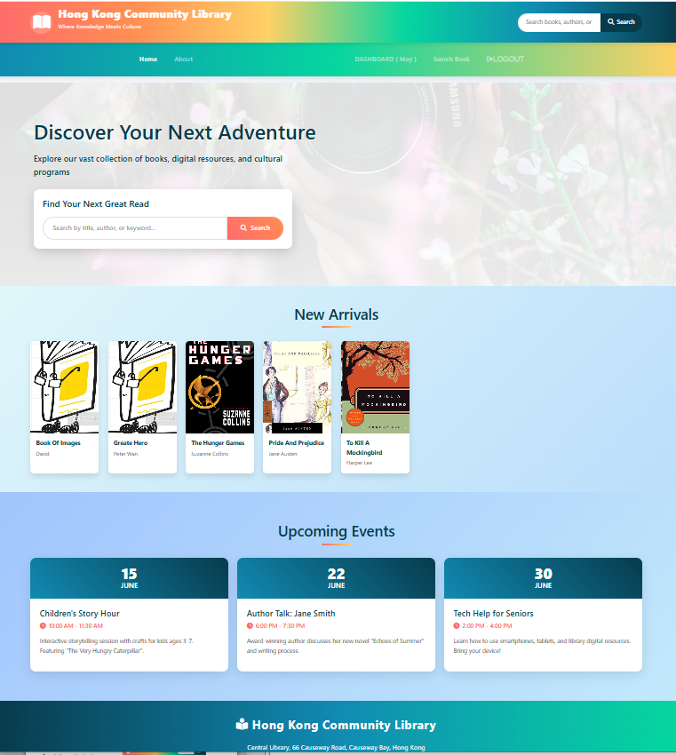
Home
- Show list of books added recently
- show upcoming events
- provide keyword book field for multi-fields

Slide 11
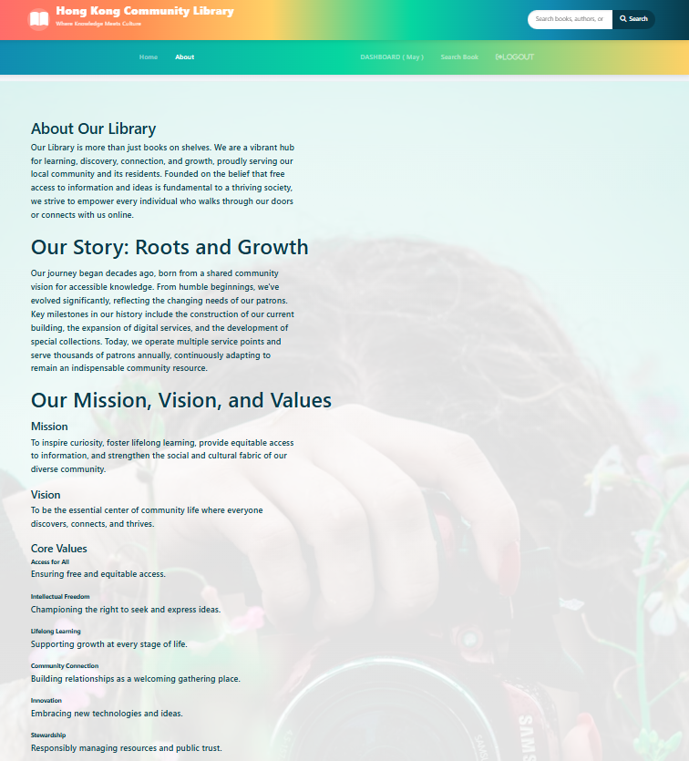
About
- Introduce the library

Slide 12
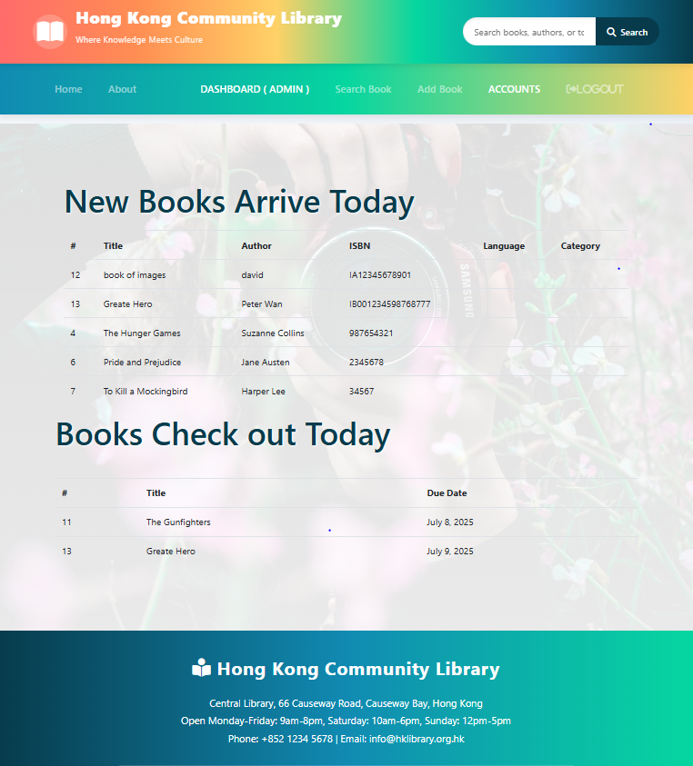
System screens - administrator
For Staff Only
Show list of new books added recently
Show list of books borrow out recently

Slide 13
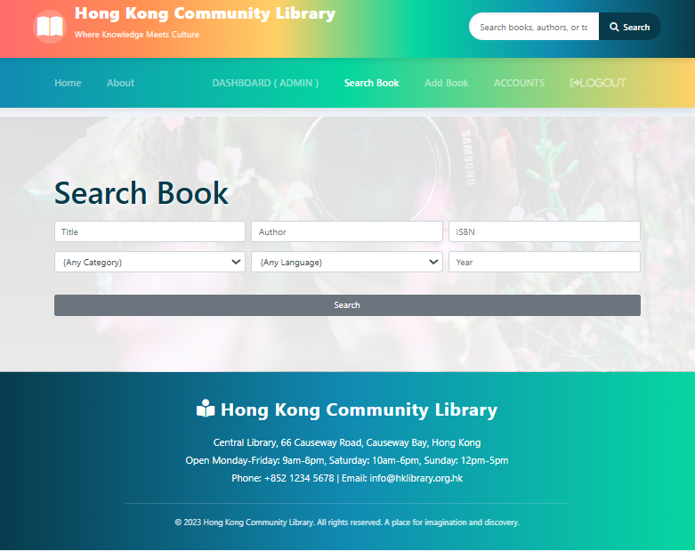
System screens - administrator
- Advance book search
Provide multi-fields query keyword search
Add book button for administrator
Manage Account button for administrator

Slide 14
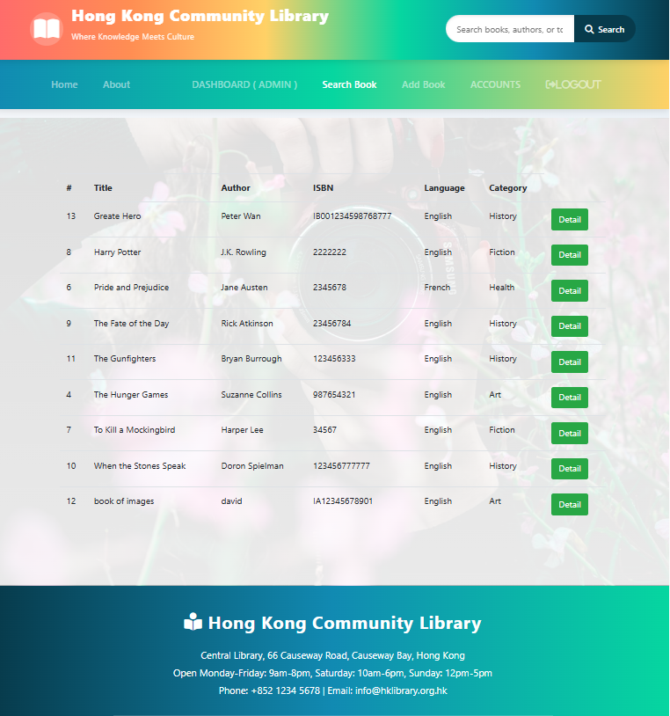
System screens - administrator
- Book search result
- Button to access details of the book

Slide 15
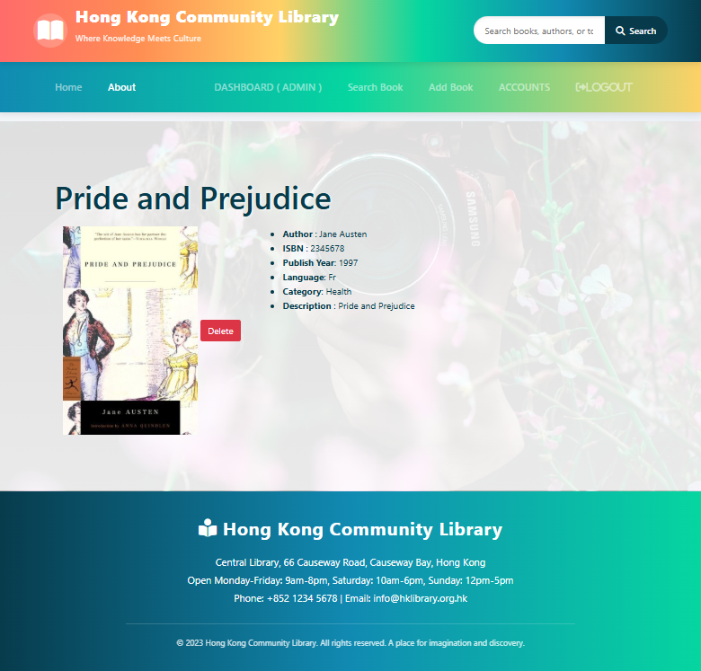
System screens - administrator
- Show the details of the book
- Delete button for administrators
- Borrow button for members

Slide 16
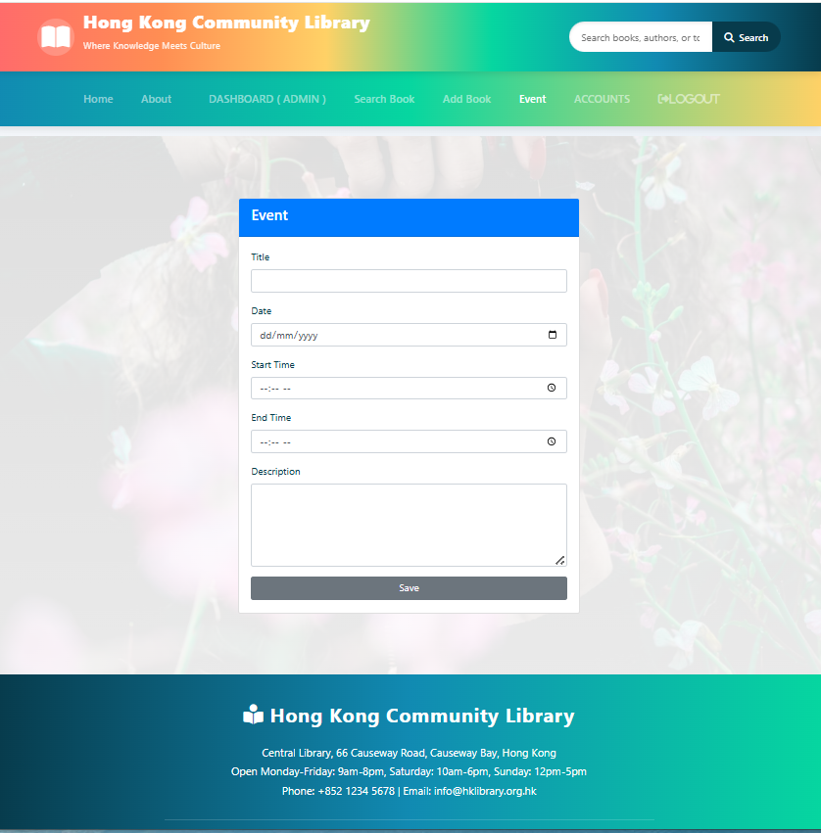
System screens - administrator
- Administrator only
- Add coming events which is display on Home Page

Slide 17
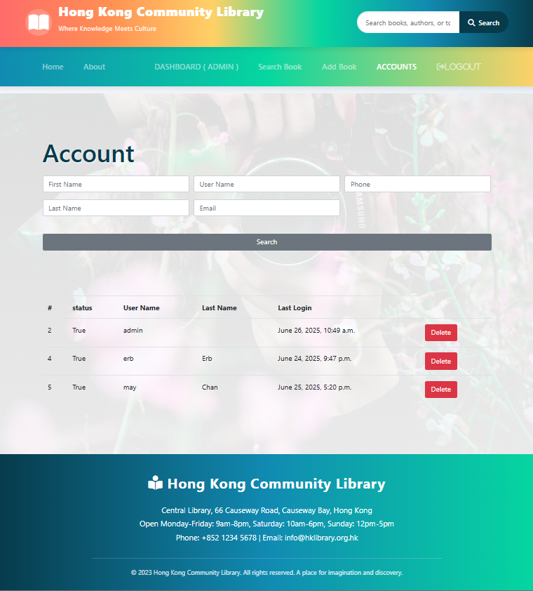
System screens - administrator
- Administrator only
- Search account
- show search account result
- Delete account button

Slide 18
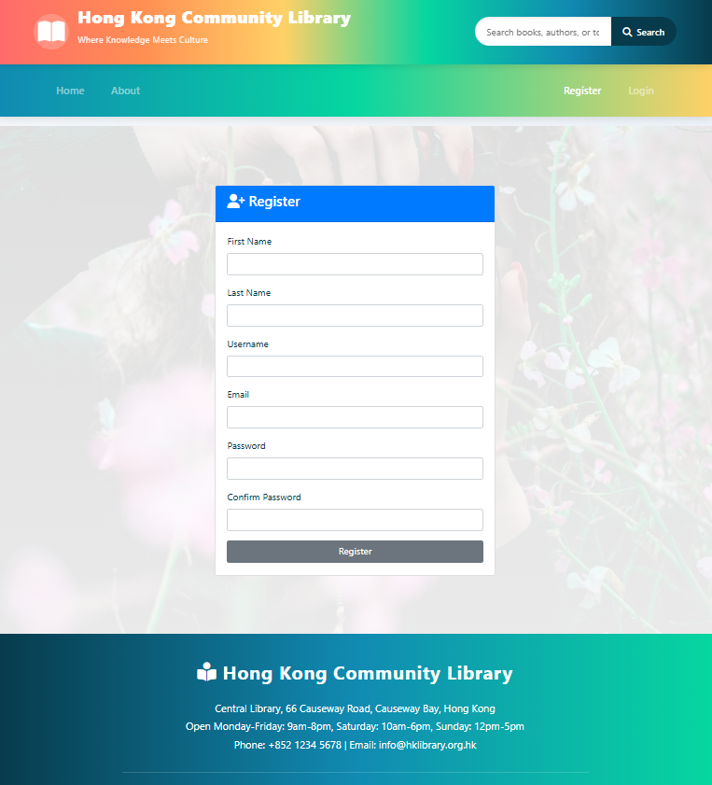
System screens - USEr
- Member register

Slide 19
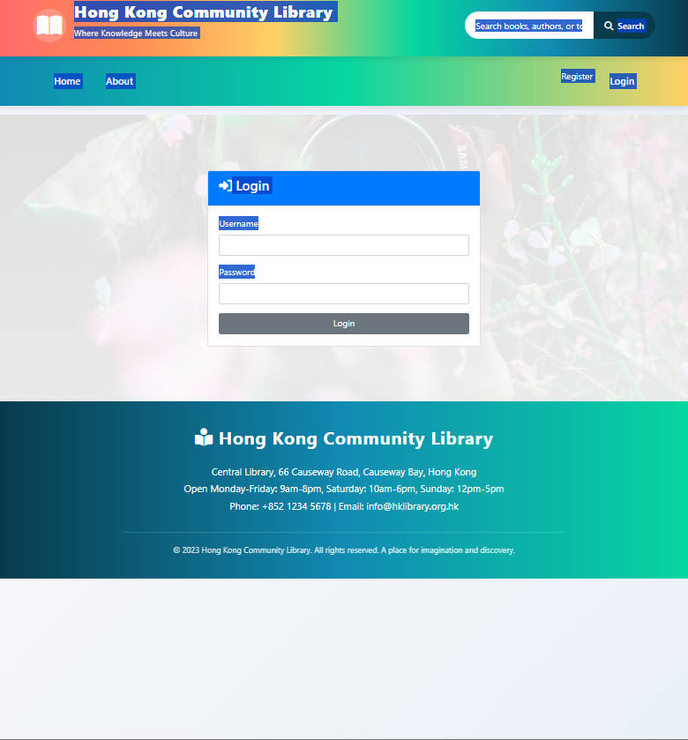
System screens - USER
User login

Slide 20
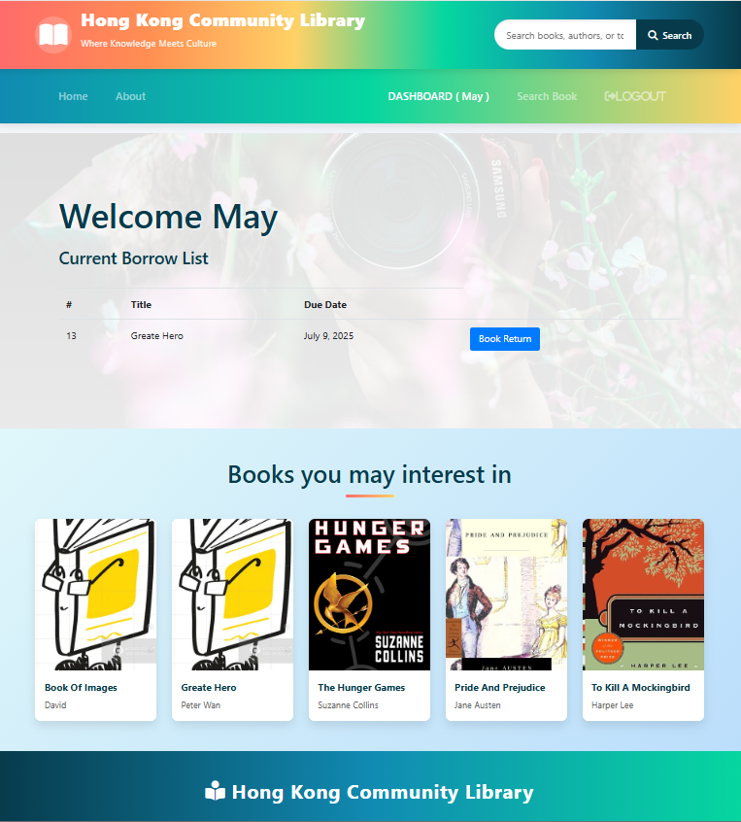
System screens - User
User Dashboard
Show borrowed book list
Book return button
Suggest book list

Slide 21
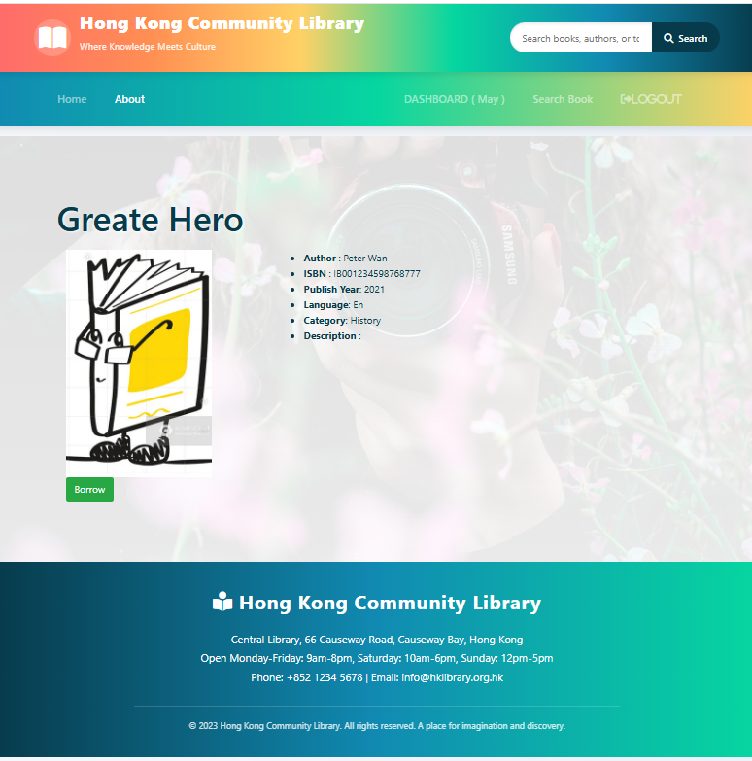
System screens - User
Book details of selected book
Borrow book button

